Slide 1
Air Pollution Monitoring System

Slide 2
TABLE OF CONTENTS
01
02
03
04
Synopsis
Drawbacks
Solution
Working Principle
05
06
07
08
Componentss
Circuit Diagram
Code
Link Of The Project

Slide 3
OUR TEAM
TANAY MONDAL
ARINDIP DUTTA
RAJA SAHA
BCA_2B_08
BCA_2B_47
BCA_2B_48

Slide 4
Synopsis
This system will help us to monitor the air quality. If there is a sensitive person this system will help him/her to warn about the air quality.

Slide 5

Drawbacks
1ST
We can’t use this system while we are out side of our home . We can only monitor air quality by physical approach.
2ND
This system is not portable .
3RD
This system is unable to detect Carbon monoxide(CO) which is a very harmful gas.

Slide 6



Solutions
1ST
If we use ESP 32 module then we can monitor our device remotely.
2ND
We can solve portability problem by using a 12volt battery.
3RD
To solve CO detecting problem we need to use MQ-9 gas sensor.

Slide 7
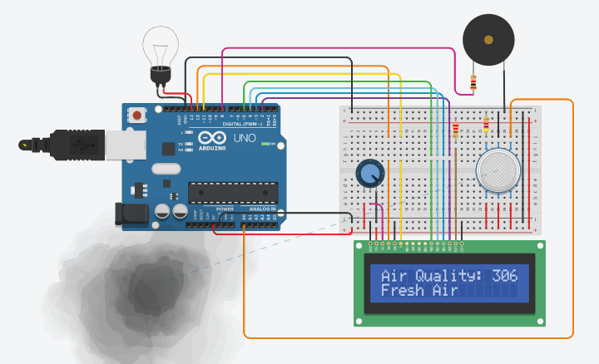
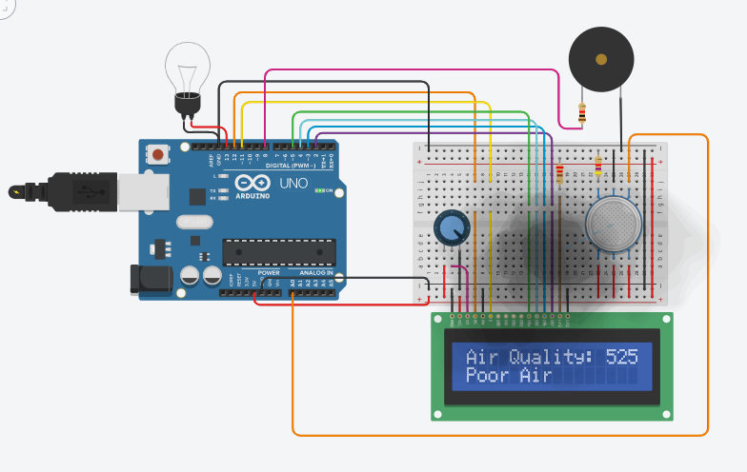
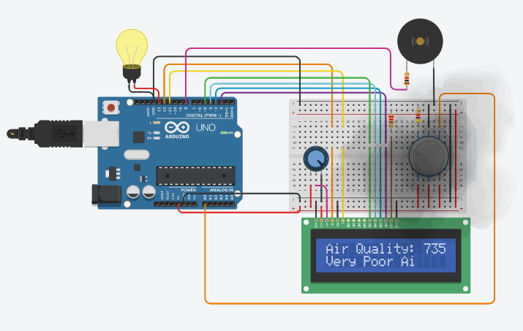
Working Principle
< 500
500-700
700 >
Air quality is Fresh.
Air quality is Poor.
Air quality is Very Poor also light up the Bulb and activate the Buzzer

Slide 8
Components
1 x
1 x
1 x
1 x
1 x
Arduino Uno R3
LCD 16 x 2
220 Ω Resistor
4.7 kΩ Resistor
10 kΩ Potentiometer
1 x
1 x
1 x
1 x
32 x
Piezo (Buzzer)
1 kΩ Resistor
MQ-135 Gas Sensor
Light bulb
Jumper Ware

Slide 9
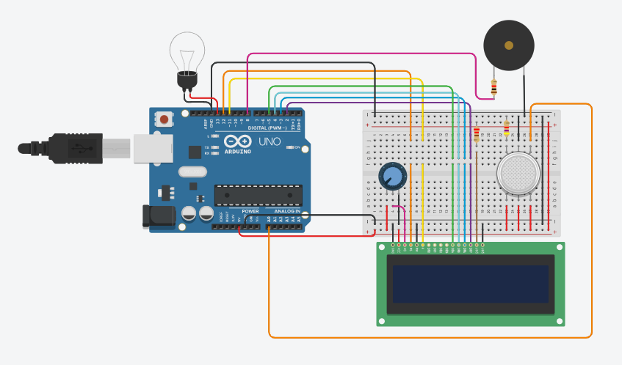
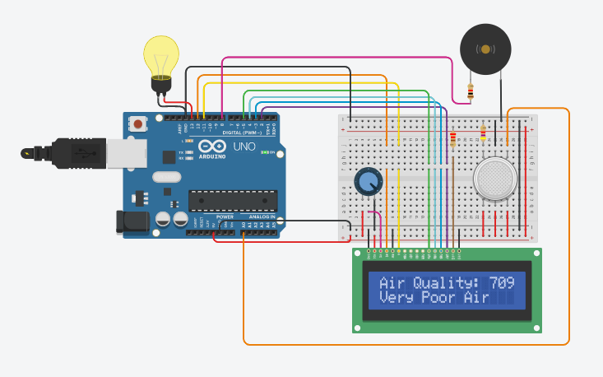
Circuit Diagram
Before Run
After Run

Slide 10
Code
#include <LiquidCrystal.h>
LiquidCrystal lcd(12, 11, 5, 4, 3, 2);
int buzzer = 8;
int analogPin = A0;
int sensorValue = 0;
int bulb=13;
void setup() {
pinMode(analogPin, INPUT);
pinMode(buzzer, OUTPUT);
pinMode(bulb, OUTPUT);
lcd.begin(16, 2);
lcd.print("What is the air ?? ");
lcd.print("quality today?");
Serial.begin(9600);
lcd.display();
}
void loop() {
delay(1000);
sensorValue = analogRead(analogPin);
Serial.print("Air Quality in PPM = ");
Serial.println(sensorValue);
lcd.clear();
lcd.setCursor(0,0);
lcd.print ("Air Quality: ");
lcd.print (sensorValue);
if (sensorValue<=500)
{
Serial.print("Fresh Air ");
Serial.print ("\r\n");
lcd.setCursor(0,1);
lcd.print("Fresh Air");
}
else if( sensorValue>=500 && sensorValue<=700 )
{
Serial.print("Poor Air");
Serial.print ("\r\n");
lcd.setCursor(0,1);
lcd.print("Poor Air");
}
else if (sensorValue>=700 )
{
Serial.print("Very Poor Air");
Serial.print ("\r\n");
lcd.setCursor(0,1);
lcd.print("Very Poor Air");
}
if (sensorValue >650) {
digitalWrite(buzzer, HIGH);
digitalWrite(bulb, HIGH);
}
else {
digitalWrite(buzzer, LOW);
digitalWrite(bulb, LOW);
}
}

Slide 11
Link To The Project
https://www.tinkercad.com/login?next=%2Fthings%2Fa5bwKKbkE6X-air-pollution-monitoring-system-%2Feditel%3Fsharecode%3DypNLsD0HHNqXYOHf8eA4PA6rxlQWi83iszt0K8gEBqc

Slide 12
Thank you !

